Slide 1
CS 211 Computer Architecture Lecture 8: Von Neumann Architecture – Part 2
Ravi Mittal
ravi.mittal@iitgoa.ac.in
Indian Institute of Technology, Goa

Slide 2
Acknowledgements
Patt and Patel book, Chapter 4, “The von Neumann Model”
Lecture slides: Prof Onur Mutlu, Course 18-447, Computer Architecture, Carnegie Mellon University
Class presentation slides on The LC-3, University of Texas at Austin CS310H - Computer Organization Spring 2010 Don Fussell

Slide 3
Last lecture: Von Neumann Model

Slide 4
The Von Neumann Model
MEMORY
Mem Addr Reg
Mem Data Reg
INPUT
Keyboard,
Mouse,
Disk…
PROCESSING UNIT
OUTPUT
Monitor,
Printer,
Disk…
ALU
TEMP
CONTROL UNIT
PC or IP
Inst Register
From Prof Onur Mutlu’s presentation

Slide 5
LC-3: A Von Neumann Machine
From Prof Onur Mutlu’s presentation
Program Counter
Control signals
(non filled-in Arrow head)
8 General Purpose Registers (GPR)
Data
(filled-in Arrow head)
Finite State Machine
(for Generating Control Signals)
Instruction Register
ALU: 2 inputs, 1 output
ALU operation
GateALU
Memory Data Register
Keyboard
KBDR (data), KBSR (status)
Memory Address
Register
Monitor - Display
DDR (data), DSR (status)
16-bit addressable
Notes:
The data path consists of all components that actually process the information during each clock cycle—the functional units that operate on the information, the registers that store information at the end of one cycle so it will be available for further use in subsequent cycles, and the buses and wires that carry information from one point to another in the data path.

Slide 6
In today’s class, we will study
Assembly and Machine Instructions
Instruction Processing
LC-3 Instruction and Microprocessor
FETCH, DECODE, EVALUATE ADDRESS, FETCH OPERANDS, EXECUTE, STORE RESULT
Instruction steps for
ADD Instruction
LDR Instruction
Datapath components and Control signal generation

Slide 7
LC-3: A Von Neumann Machine
The control Unit
Two bit output ALUK: which controls the operation of ADD, AND, and NOT
Output GateALU determines whether or not the output of the ALU is provided to the processor bus during the current clock cycle

Slide 8
The Von Neumann Model/Architecture: Properties
Also called Stored Program Computer (instructions in memory)
Two key properties:
Stored program
Instructions stored in a linear memory array
Memory is unified between instructions and data
The interpretation of a stored value depends on the control signals
Sequential instruction processing
One instruction processed (fetched, executed, and completed) at a time
Program counter (instruction pointer) identifies the current instruction
Program counter is advanced sequentially except for control transfer instructions (eg. Jump or branch)
When is a value interpreted as an instruction?
From Prof Onur Mutlu’s presentation

Slide 9
The Von Neumann Model: Instruction Processing
The program and data are stored as a sequence of bits in the computer memory
The program is executed one instruction at a time under the direction of the control unit
Control unit interprets instructions: generates a sequence of control signals to carry out operations
The most basic unit of computer processing: Instruction. It consists of
Opcode : Operations to be performed
Operands: Data/Locations to be used for operation
Example:
add $s0, $s1, $s2

Slide 10
LC-3 Instruction set and Microprocessor
Little Computer – 3
For educational purpose
Simple Instruction Set : 15 Opcodes
16-bit
Addressing modes: immediate, register, PC relative, Indirect, base+Offset
We will use LC-3 only for explanation
Later in the course, we will study RISC-V for programming / design

Slide 11
LC-3: A Von Neumann Machine
From Prof Onur Mutlu’s presentation
Program Counter
Control signals
(non filled-in Arrow head)
8 General Purpose Registers (GPR)
Data
(filled-in Arrow head)
Finite State Machine
(for Generating Control Signals)
Instruction Register
ALU: 2 inputs, 1 output
ALU operation
GateALU
Memory Data Register
Keyboard
KBDR (data), KBSR (status)
Memory Address
Register
Monitor - Display
DDR (data), DSR (status)
16-bit addressable
Notes:
The data path consists of all components that actually process the information during each clock cycle—the functional units that operate on the information, the registers that store information at the end of one cycle so it will be available for further use in subsequent cycles, and the buses and wires that carry information from one point to another in the data path.

Slide 12
About Assembly and Machine Instructions

Slide 13
Instruction Types
There are three main types of instructions
Operate instructions
Execute instructions in the ALU
Ex: ADD
Data movement instructions
Read from or write to memory
Ex: Load LD, Store
Control flow instructions
Change the sequence of execution
Branch, Jump etc
Based on decision making

Slide 14
An Example Operate Instruction
Addition
add: mnemonic to indicate the operation to perform
b, c: source operands
a: destination operand
a ← b + c
High-level code
Assembly
a = b + c;
add a, b, c
From Prof Onur Mutlu’s presentation

Slide 15
Registers
We map variables to registers
Assembly
LC-3 registers
add R0, R1, R2
b = R1
c = R2
a = R0

Slide 16
From Assembly to Machine Code in LC-3
Addition
LC-3 assembly
ADD R0, R1, R2
Machine Code
OP
DR
SR1
SR2
0 0 0 1
0 0 0
0 0 1
0
0 0
0 1 0
15
14
13
12
11
10
9
8
7
6
5
4
3
2
1
0
0x1042
Machine Code, in short (hexadecimal)
From Prof Onur Mutlu’s presentation

Slide 17
Instruction Format (or Encoding)
LC-3
OP = opcode (what the instruction does)
Example: ADD = 0001
Semantics: DR ← SR1 + SR2
Example: AND = 0101
Semantics: DR ← SR1 AND SR2
SR1, SR2 = source registers
DR = destination register
15
14
13
12
11
10
9
8
7
6
5
4
3
2
1
0
OP
DR
SR1
0
00
SR2
4 bits
3 bits
3 bits
3 bits
From Prof Onur Mutlu’s presentation

Slide 18
Instruction Processing

Slide 19
Instruction Processing
Fetch instruction from memory
Decode instruction
Evaluate address
Fetch operands from memory
Execute operation
Store result

Slide 20
ADD Instruction
LC-3 assembly
ADD R0, R1, R2

Slide 21
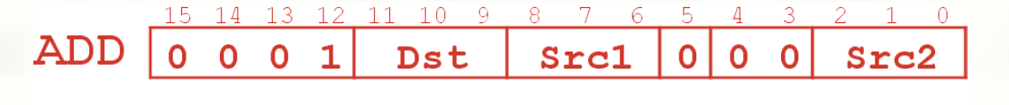
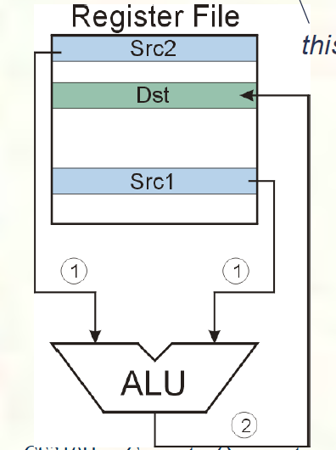

ADD Instruction

Slide 22
ADD Instruction: FETCH
Load the instruction (at address stored in PC) from memory into Instruction Register (IR)
Copy contents of PC into MAR
Send “read” signal to memory
Copy contents of MDR into IR
Then increment PC, so that it points to the next instruction in sequence
PC becomes PC+1
Note that LC-3 is word addressable
If it was byte addressable, PC would have been incremented by 2
F
D
EA
OP
EX
S

Slide 23
ADD Instruction: FETCH
From Prof Onur Mutlu’s presentation
Step 1: Load MAR and increment PC
Step 2: Access memory
Step 3: Load IR with the content of MDR

Slide 24
ADD Instruction: DECODE
First identify the opcode
In LC-3, it is 4-to-16 decoder
The input is the four bits IR[15:12]
Depending on opcode, identify the operands from the remaining bits
F
D
OP
DR
SR1
SR2
0 0 0 1
0 0 0
0 0 1
0
0 0
0 1 0
EA
OP
EX
S

Slide 25
ADD Instruction: DECODE
From Prof Onur Mutlu’s presentation
DECODE identifies the instruction to be processed

Slide 26
ADD Instruction: EVALUATE ADDRESS
Computes the address of the memory location that is needed to process the instruction
ADD instruction has operands in registers
This step is not necessary in ADD
F
D
EA
OP
EX
S
ADD R0, R1, R2

Slide 27
ADD Instruction: FETCH OPERANDS
The FETCH OPERANDS phase obtains the source operands needed to process the instruction
In ADD
Obtain the source operands from the register file
F
D
EA
OP
EX
S

Slide 28
ADD Instruction - FETCH Operands
From Prof Onur Mutlu’s presentation
Fetch Registers from Register File

Slide 29
ADD Instruction: EXECUTE
Perform the operation, using the source operands
For ADD instruction do add contents of two operand Registers – see next slide
F
D
EA
OP
EX
S

Slide 30
ADD Instruction: EXECUTE
From Prof Onur Mutlu’s presentation
ADD adds SR1 and SR2
ADD Instruction

Slide 31
ADD Instruction: STORE Result
The STORE RESULT phase writes to the designated destination – Register R0
Once STORE RESULT is completed, a new instruction cycle starts (with the FETCH phase)
F
D
EA
OP
EX
S

Slide 32
ADD Instruction: STORE Result
From Prof Onur Mutlu’s presentation

Slide 33
LDR Instruction
LC-3 assembly
LDR R3, R0, #2
R3 ← Memory[R0 + 2]
These instructions use a particular addressing mode
(i.e., the way the address is calculated), called base+offset

Slide 34
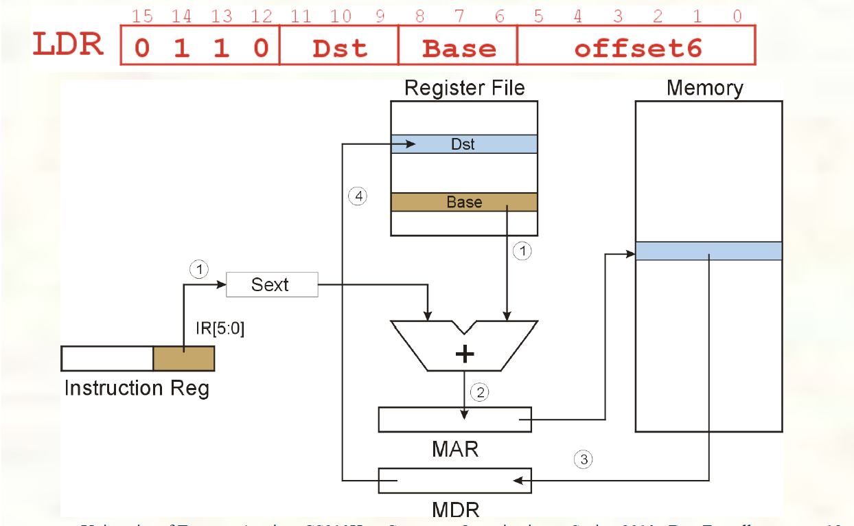
LDR Instruction – All steps

Slide 35
LDR Instruction: FETCH Instruction
Load the instruction (at address stored in PC) from memory into Instruction Register (IR)
Copy contents of PC into MAR
Send “read” signal to memory
Copy contents of MDR into IR
Then increment PC, so that it points to the next instruction in sequence
PC becomes PC+1
Note that LC-3 is word addressable
If it was byte addressable, PC would have been incremented by 2
F
D
EA
OP
EX
S

Slide 36
LDR Instruction: FETCH
Step 1: Load MAR and increment PC
Step 2: Access memory
Step 3: Load IR with the content of MDR

Slide 37
LDR Instruction: DECODE
First identify the opcode
In LC-3, it is 4-to-16 decoder
The input is the four bits IR[15:12]
F
D
EA
OP
EX
S

Slide 38
Instruction Processing: EVALUATE ADDRESS
Computes the address of the memory location that is needed to process the instruction
This phase is necessary in LDR (Load)
It computes the address of the data word that is to be read from memory
By adding an offset to the content of a register
F
D
EA
OP
EX
S

Slide 39
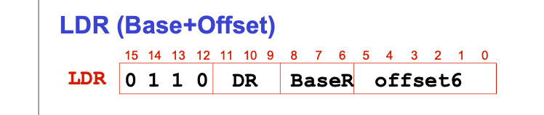
LDR Instruction: EVALUATE Address
LDR Instruction
LDR calculates the address by adding a register and an immediate
ADD

Slide 40
LDR Instruction: FETCH Operands
Step 1: Load MAR with the address calculated in EVALUATE ADDRESS
Step 2: Read memory, placing source operand in MDR
F
D
EA
OP
EX
S

Slide 41
LDR Instruction: FETCH OPERANDS
LDR loads MAR (step 1), and places the results in MDR (step 2)

Slide 42
LDR Instruction: EXECUTE
Do nothing for LDR
F
D
EA
OP
EX
S

Slide 43
LDR Instruction: STORE Result
The STORE RESULT phase writes to the designated destination register
F
D
EA
OP
Example
EX
LDR R3, R0, #2
S

Slide 44
LDR instruction: Store Result
LDR loads MDR into DR

Slide 45
The Instruction Cycle
FETCH
DECODE
EVALUATE ADDRESS
FETCH OPERANDS
EXECUTE
STORE RESULT

Slide 46
Changing the Sequence of Instructions
In the FETCH phase, we increment the Program Counter by 1
What if we don’t want to always execute the instruction that follows this one?
examples: loop, if-then, function call
Need special instructions that change the contents of the PC
These are called control instructions.
jumps are unconditional - they always change the PC
branches are conditional - they change the PC only if some condition is true (e.g., the result of an ADD is zero)

Slide 47
Changing the Sequence of Instructions
Control instructions allow a program to execute out of sequence
They can change the PC by loading it during the EXECUTE phase
That wipes out the incremented PC (loaded during the FETCH phase)

Slide 48
Jump in LC-3
Unconditional branch or jump
LC-3
BaseR = Base register
PC ← R2 (Register identified by BaseR)
JMP R2
1100
000
BaseR
000000
4 bits
3 bits
This is register addressing mode
Notes:
jr is R-Type

Slide 49
LC-3 Data Path and Control signals
GatePC
PC Multiplexer
LD.IR
GateMDR
LD.MAR

Slide 50
Control of the Instruction Cycle
State 1
The FSM asserts GatePC and LD.MAR
It selects input (+1) in PCMUX and asserts LD.PC
State 2
MDR is loaded with the instruction
State 3
The FSM asserts GateMDR and LD.IR
State 4
The FSM goes to next state depending on opcode
State 63
JMP loads register into PC

Slide 51
Instruction Processing Summary
Instructions look just like data - it’s all interpretation
Three basic kinds of instructions:
Computational instructions (ADD, AND, …)
Data movement instructions (LD, ST, …)
Control instructions (JMP, BRnz, …)
Six basic phases of instruction processing:
F → D → EA → OP → EX → S
Not all phases are needed by every instruction
Phases may take variable number of machine cycles

Slide 52
Class Summary
In this class we have studied
Step-by-step instruction processing in LC-3
Data path components

Slide 53
Backup slides

Slide 54
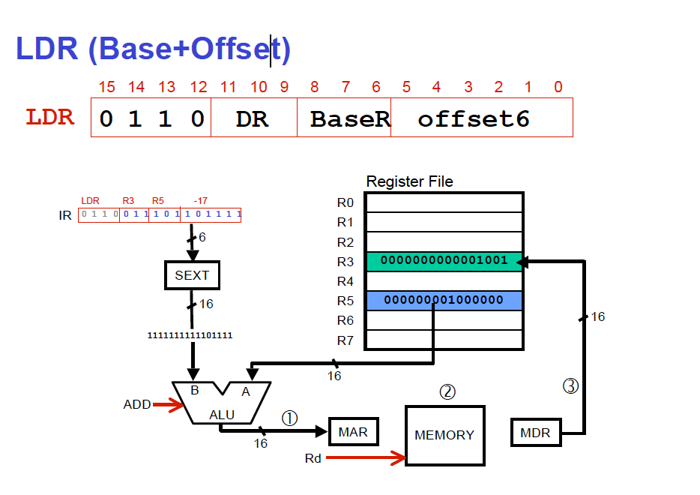
LDR instruction
Back

Slide 55
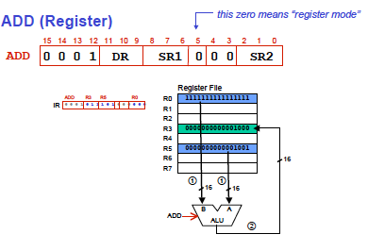
ADD Instruction in LC-3
Back

Slide 56
What is Data path?
The data path consists of all components that actually process the information during each clock cycle
the functional units that operate on the information: ALU
the registers that store information at the end of one cycle so it will be available for further use in subsequent cycles
the buses and wires that carry information from one point to another in the data path
PC, MAR, MUXES, Condition code logic, Control unit etc
Control signals are associated with each component in the data path
ALUK (2 control signals) associated with ALU
These define how ALU will be used in each cycle
LD.IR 1
GATE PC 1
n LC-3, there are 42 control signals that control the elements data path in cycle

Slide 57
The Von Neumann Model - Summary
John von Neumann proposed a fundamental model of a computer for processing computer programs in 1946
It consists of five parts: memory, a processing unit, input, output, and a control unit.
The computer program is contained in the computer’s memory
Data comes from Program’s memory or input devices
It defines Von Neumann Architecture consisting of
ALU, Control Unit, Memory, Input, Output, Registers etc
Six phases of instruction cycle: Fetch, Decode, Evaluate Address, Fetch Operands, Execute, and store result

Slide 58
Addressability
How the bits are accessed determines the addressability
E.g., word-addressable
E.g., 8-bit addressable (or byte-addressable)
The total number of addresses is the address space
In MIPS, the address space is 2³²
32-bit addresses
In x86-64, the address space is (up to) 2⁴⁸
48-bit addresses
In RISC-V, the address space
32-bit, 64-bit, and 128-bit (we will consider only 32-bit)

Slide 59
The Von Neumann Model: Terminology
MAR: Memory Address Register
Contains the address of memory location where data is to be read/written
MDR: Memory Data Register
Contains the data/information that is read from a specified memory location or to be written to the memory location
ALU: Arithmetic and Logic Unit
Capable of performing basic arithmetic functions (ADD and SUBTRACT) and logic operations (bit-wise AND, OR, and NOT)
Word: Data Element
Word length: ALU processes data element of a fixed size called word length; Each ISA has own word length (eg. 32 bits or 64 bits)
Registers: Temporary Storage
32 registers or 64 registers each of length 32 bits, 64 bits, 128 bits

Slide 60
Time to Complete One Instruction
It takes fixed number of clock ticks (repetition of rising or falling edge) to execute each instruction
Hence the clock sequences each phase of an instruction by raising the right signals as the right time
So what determines the time between ticks i.e. the length of the clock cycle?

